Slide 1

Project: TA Report Web App
IE04 Weekly Progress Report, Phase Demo 2
2023/12/06
Team: Pikachu

Slide 2
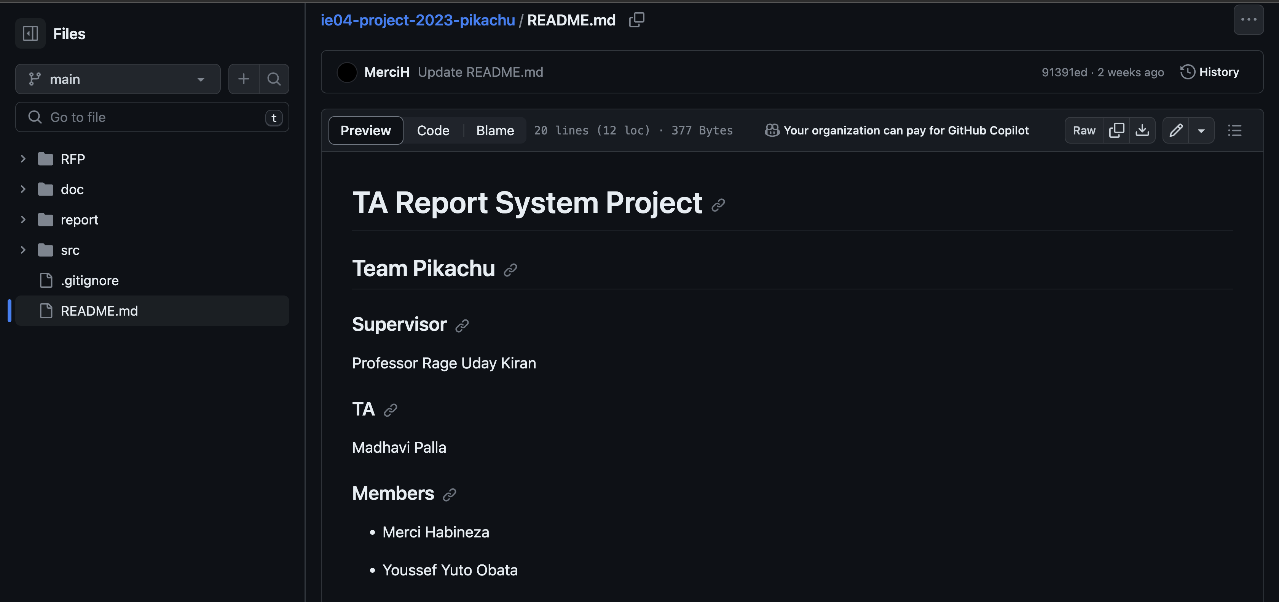
Introduction

Slide 3
Activities of Previous Week
Task | Member | Work Hours
(UI front-end) login screen | Youssef | 5:30
(UI front-end) TA course screen | Youssef | 9:30
(UI front-end) TA report screen | Youssef | 8:30
(back-end) Database | Merci | 5:30
(back-end) API | Merci | 20:30
 | Total time: | 57h:00

Slide 4
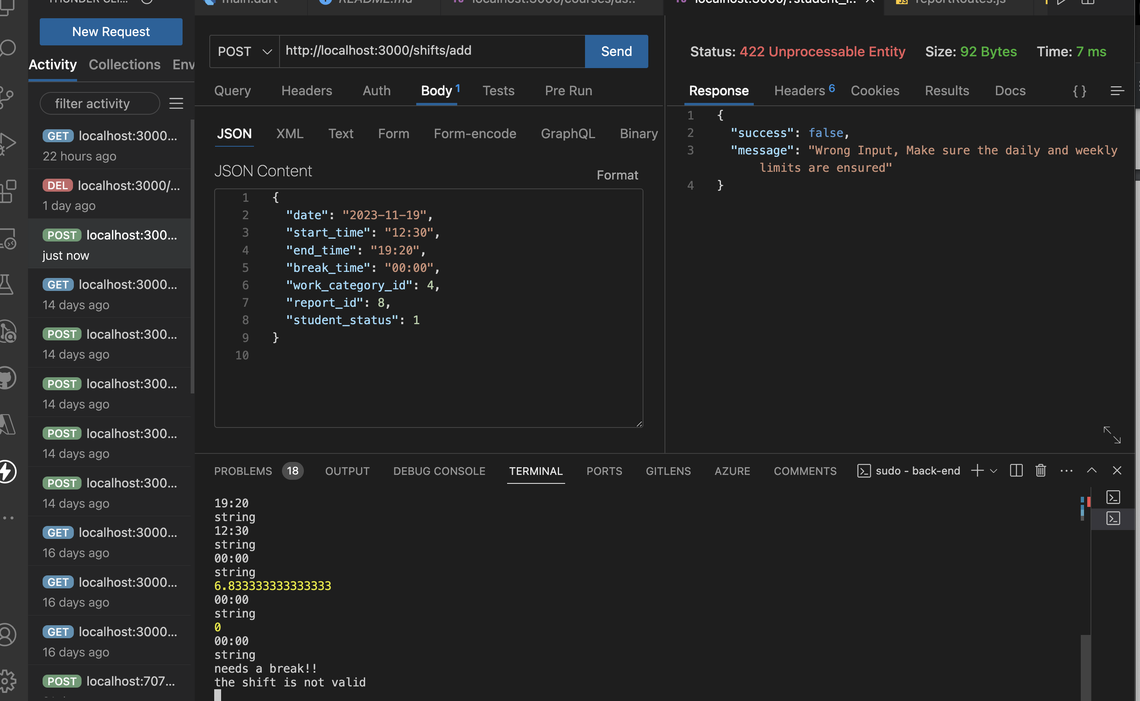
API

Slide 5
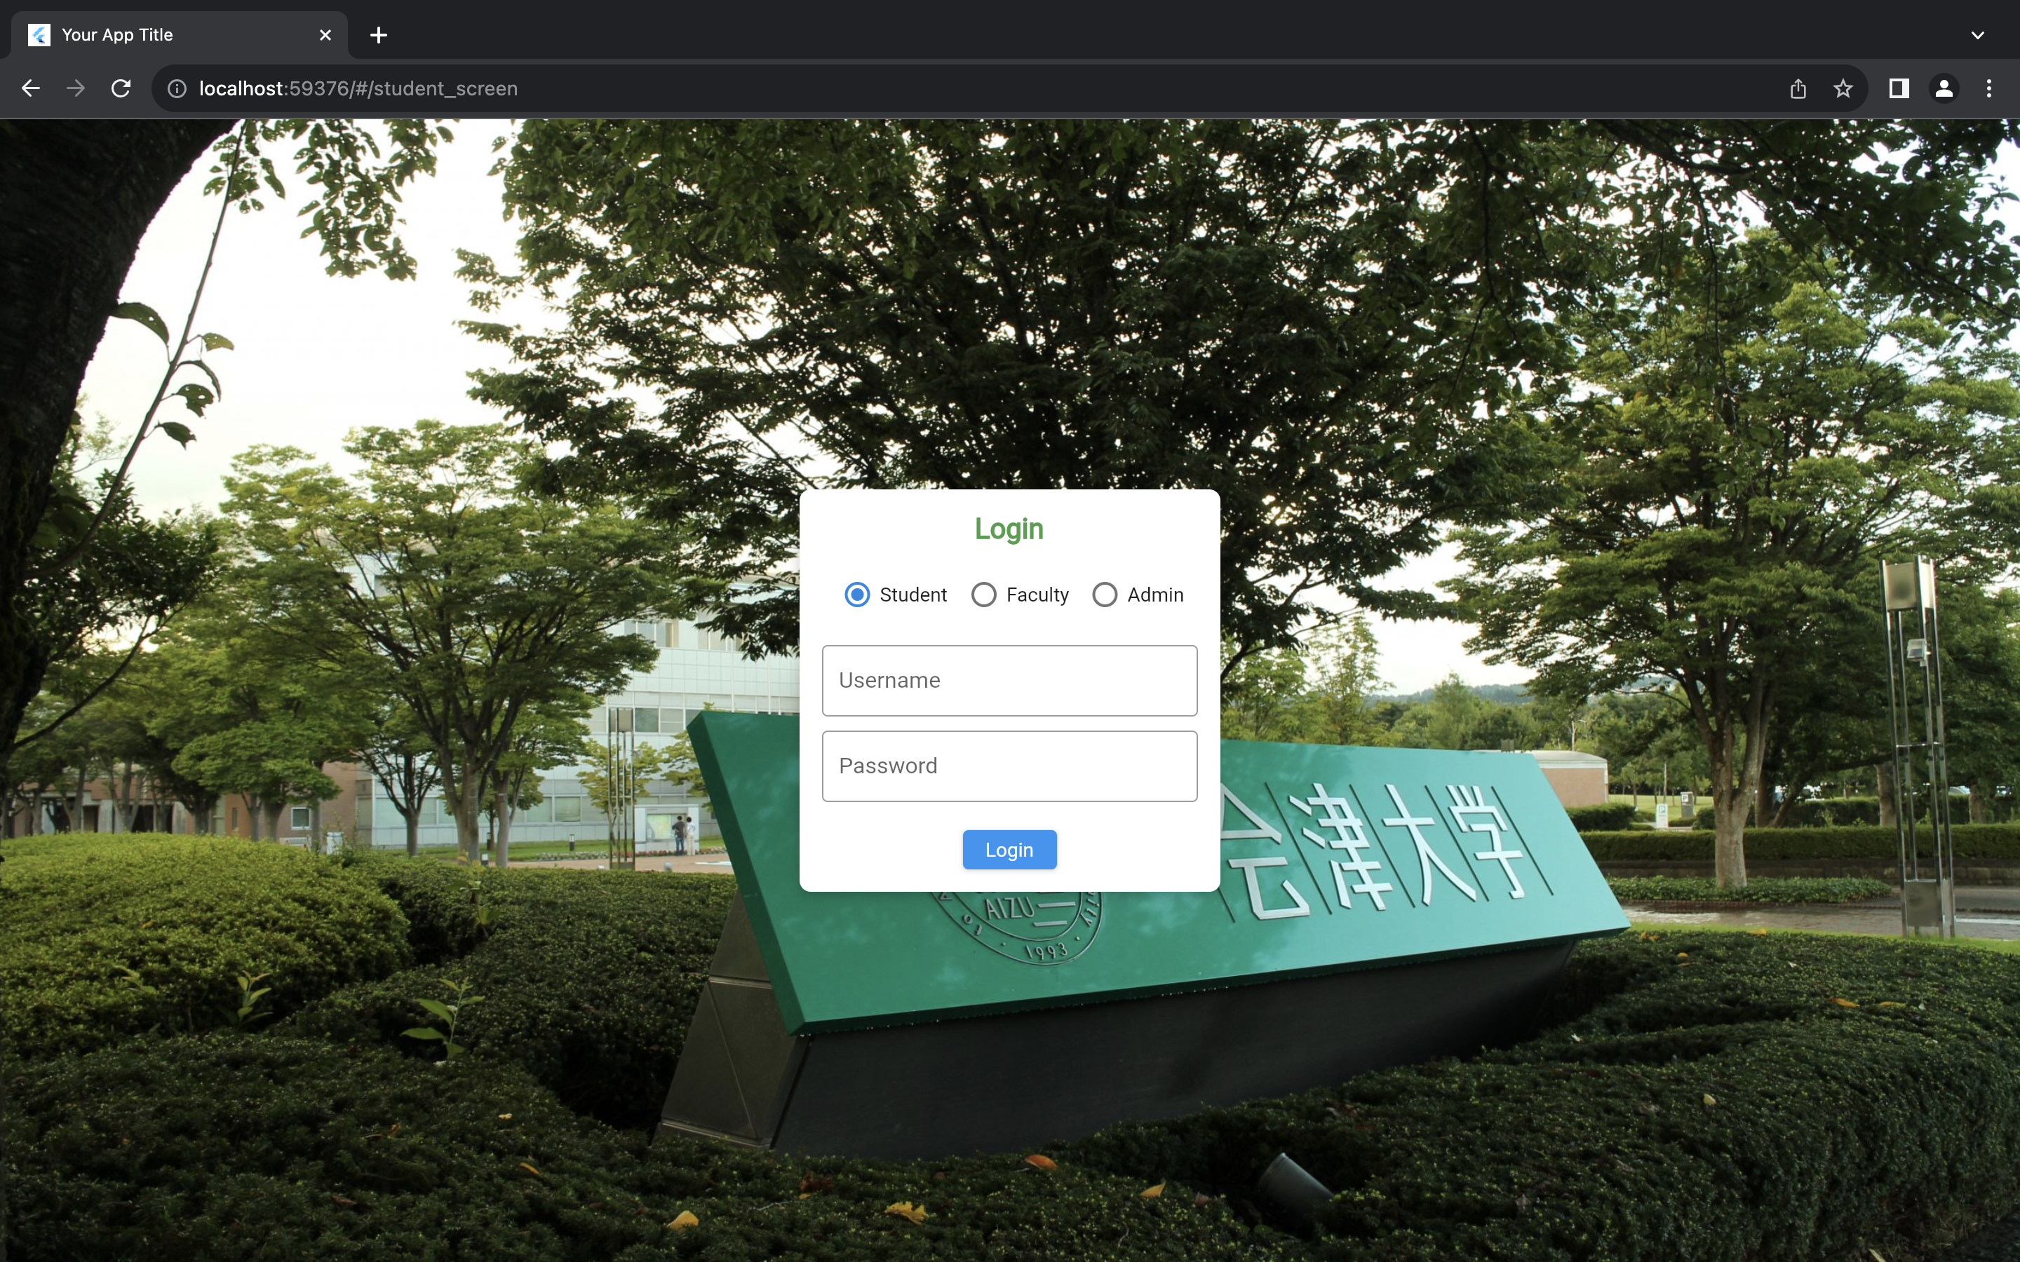
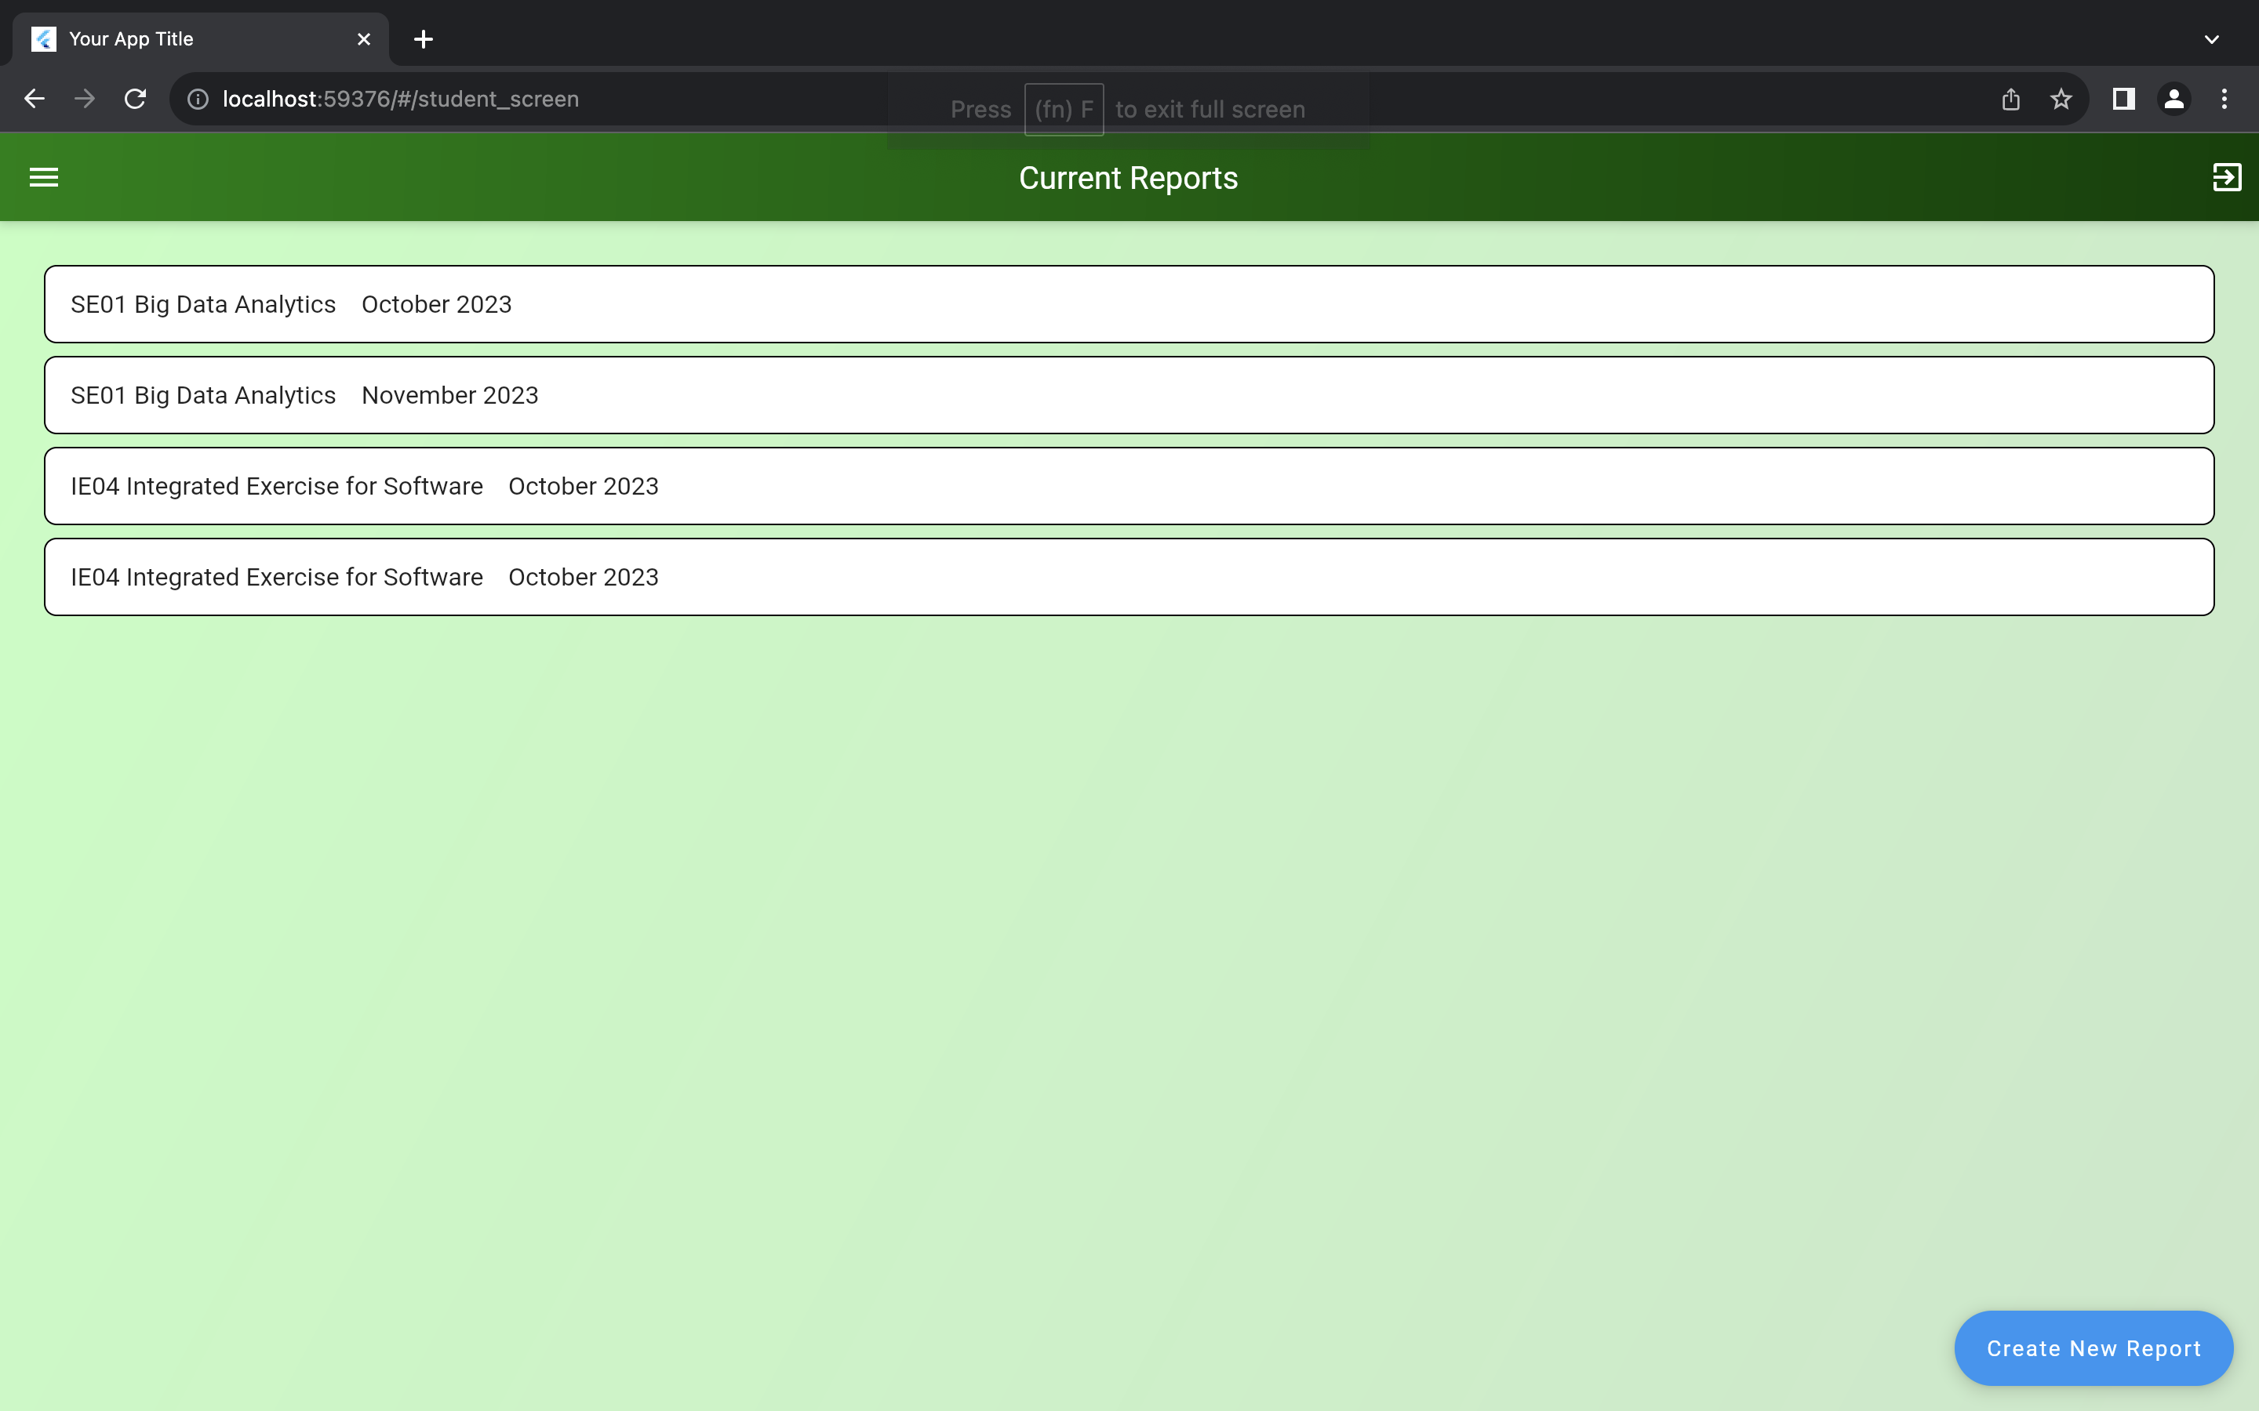
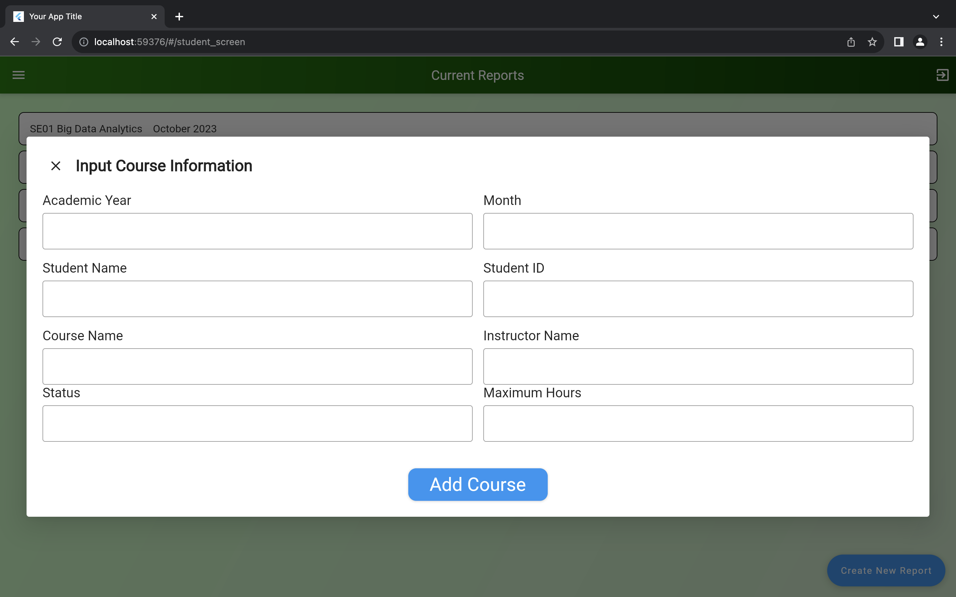
Front-End

Slide 6
Plan for Next Week
Task | Member | Work Hours
(Front-end& back-end) API connect (Wednesday) | Youssef & Merci | 2:30
(back-end) Authentication API (start from Saturday) | Merci | 8:00
(Front-end) Authentication (start from Saturday) | Youssef | 5:30
 | Total time: | 16h:00

Slide 7
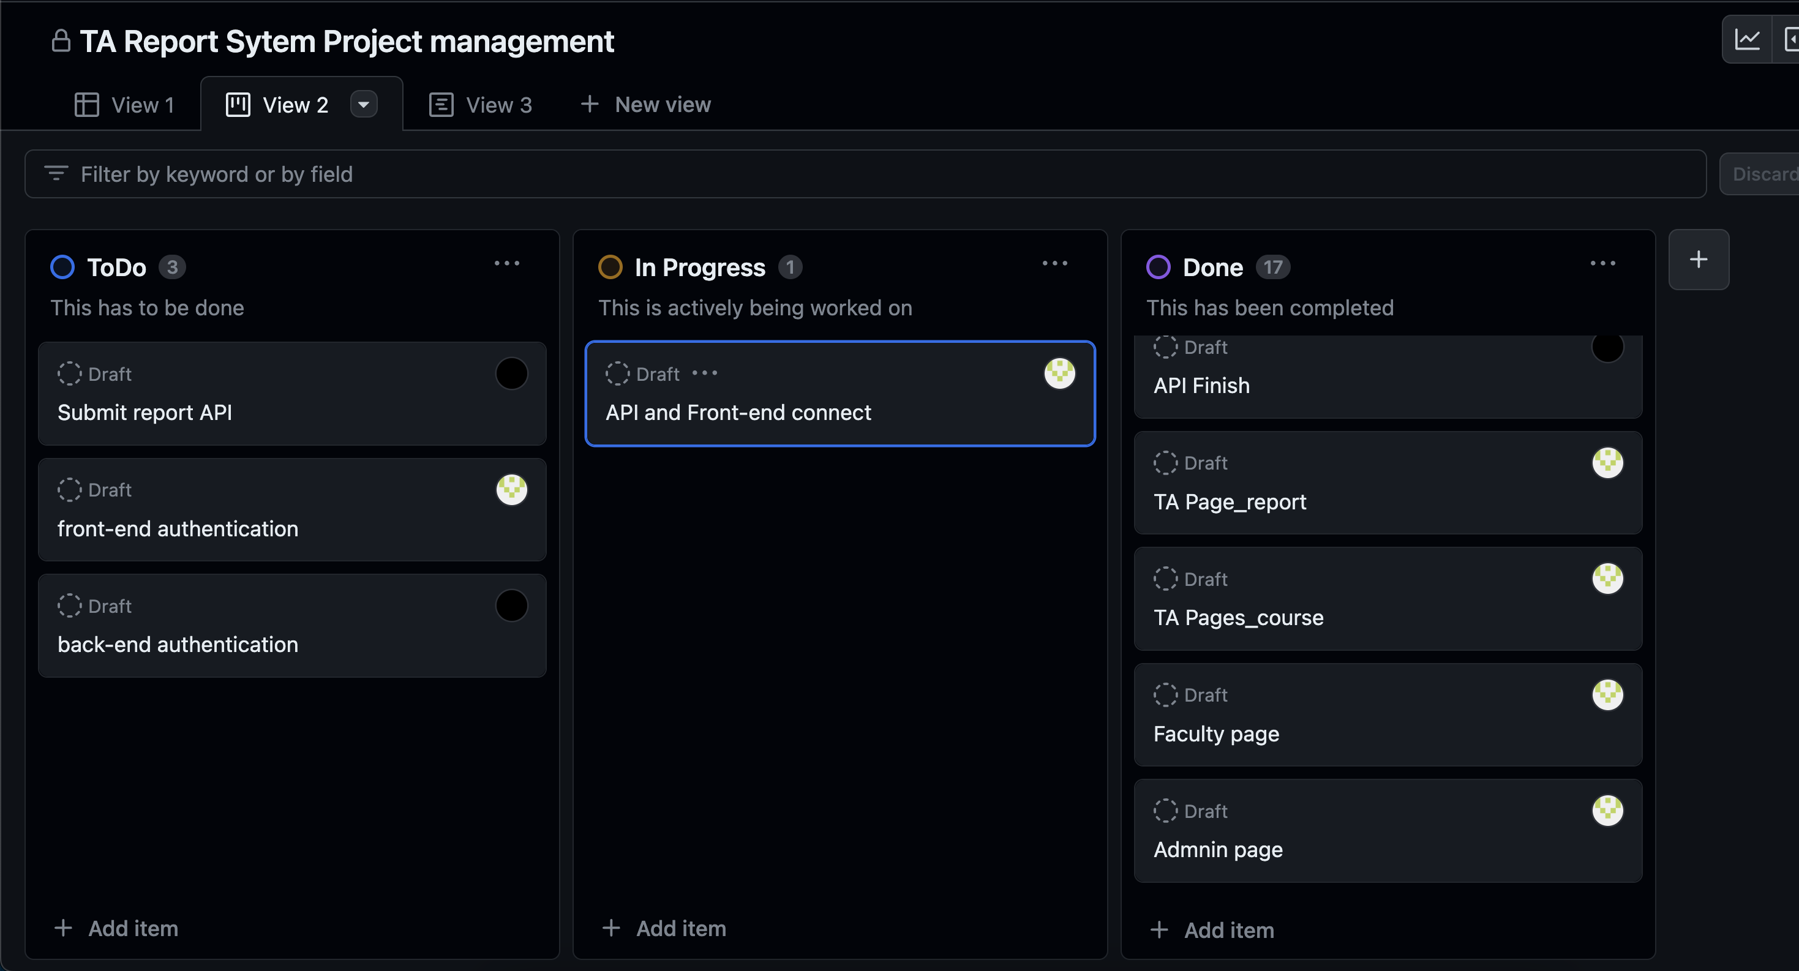
Phase Task Board

Slide 8
Issues & Risks (*if any)
Problem: API errors, still implementing time restrictions
Cause: Unchecked Bugs
Possible Solution: do all checks for negative and wrong inputs
Deadline: Dec 20, 2023

Slide 9

Thank you

